Slide 1
1991
Notes:
The year is 1991
The Soviet Union had just dissolved into its member states
And today, I wanna talk with you about my research---

Slide 2
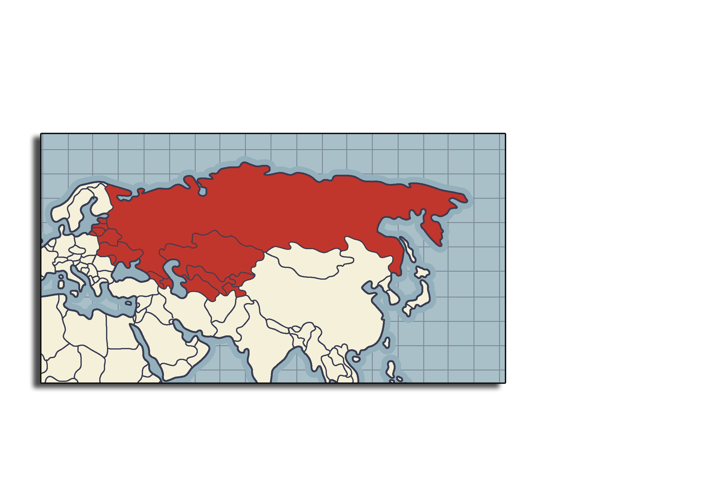
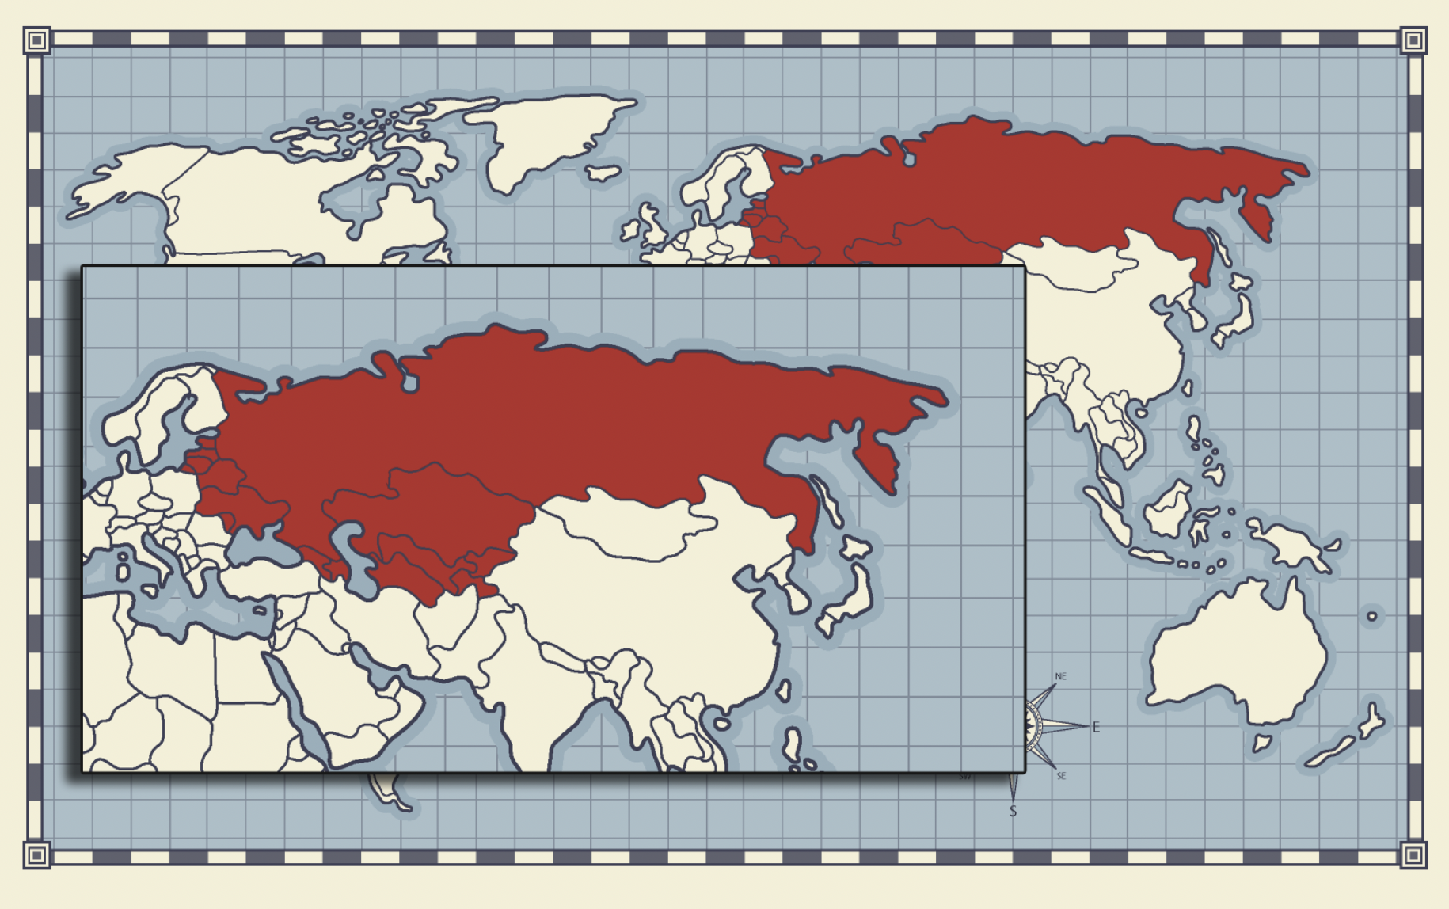
ON THE CRISIS OF 1991
Notes:
On the crisis of 1991!

Slide 3
BACKGROUND
Armenia
Azerbaijan
Belarus
Estonia
Georgia
Kazakhstan
Kyrgyzstan
Latvia
Lithuania
Moldova
Russia
Tajikistan
Turkmenistan
Ukraine
Uzbekistan
16. Poland
17. Slovakia
18. Czech
19. Hungary
20. East Germany
21. Romania
Notes:
First, some background
USSR in 1922
Warsaw Pact in 1955
Khrushchev, Gorbachev
Dissolved in 15 member states and lost power over the remaining Warsaw states
Peak pop. Size of 280m
USSR GDP was falling behind by 1/5th of the USA even though they started at close margin

Slide 4
BACKGROUND
Armenia
Azerbaijan
Belarus
Estonia
Georgia
Kazakhstan
Kyrgyzstan
Latvia
Lithuania
Moldova
Russia
Tajikistan
Turkmenistan
Ukraine
Uzbekistan
16. Poland
17. Slovakia
18. Czech
19. Hungary
20. East Germany
21. Romania

Slide 5
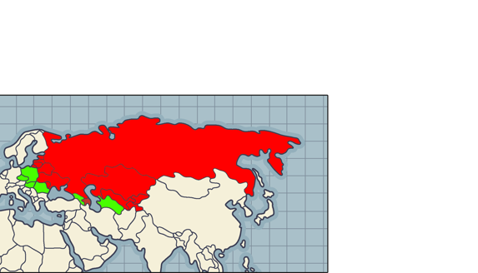
BACKGROUND
Armenia
Azerbaijan
Belarus
Estonia
Georgia
Kazakhstan
Kyrgyzstan
Latvia
Lithuania
Moldova
Russia
Tajikistan
Turkmenistan
Ukraine
Uzbekistan
16. Poland
17. Slovakia
18. Czech
19. Hungary
20. East Germany
21. Romania

Slide 6
FACT
Armenia
Azerbaijan
Belarus
Estonia
Georgia
Kazakhstan
Kyrgyzstan
Latvia
Lithuania
Moldova
Russia
Tajikistan
Turkmenistan
Ukraine
Uzbekistan
16. Poland
17. Slovakia
18. Czech
19. Hungary
The decrease in the life expectancy of males in Russia from 1991 to 1994 was an “almost unprecedented decrease in life expectancy in three years”¹
¹Brainerd, E. (2021). Mortality in Russia Since the Fall of the Soviet Union. Comparative Economic Studies, 63(4), 557–576. https://doi.org/10.1057/s41294-021-00169-w
Notes:
For comparison, the increase in mortality due to COVID-19 is projected to decrease US life expectancy by 1.13 years in 2020 (Andrasfay and Goldman 2021).
Male life expectancy at birth in Russia fell by six years between 1991 and 1994, from an already-low 63.4 years to 57.4 years over that period, an almost unprecedented decrease in life expectancy in three years

Slide 7
THE LITERATURE
Armenia
Azerbaijan
Belarus
Estonia
Georgia
Kazakhstan
Kyrgyzstan
Latvia
Lithuania
Moldova
Russia
Tajikistan
Turkmenistan
Ukraine
Uzbekistan
16. Poland
17. Slovakia
18. Czech
19. Hungary
Alcohol-specific Reasons
Economy-specific reasons
Affordability theory
Rebound theory
Sharp decrease in life quality
Decrease in perceived wellbeing
e.g. Bhattacharya, Yakovlev
e.g. Azarova, Brianerd
Notes:
For comparison, the increase in mortality due to COVID-19 is projected to decrease US life expectancy by 1.13 years in 2020 (Andrasfay and Goldman 2021).

Slide 8

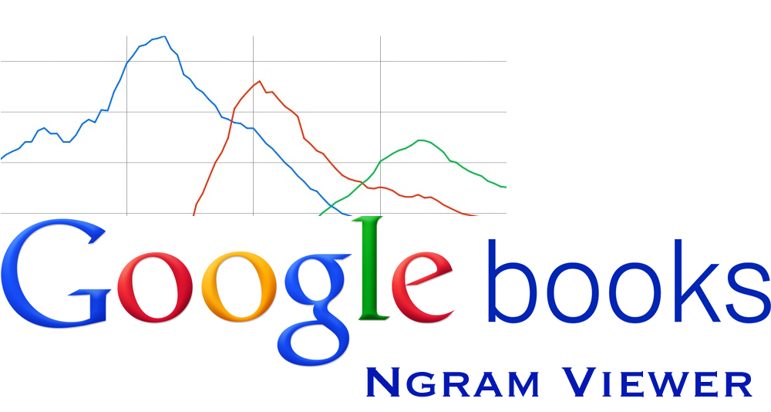
QUESTION
To what extent did “the perceived well-being” and “economic change pace or degree” affect the mortality crisis in New Independent States and Central Soviet States?

Slide 9
HYPOTHESIS
Economic changes and decreases in life quality correlated with mortality spikes; this is in contrast with “perceived well-being” and alcohol-specific reasons.

Slide 10

DATA & METHODS
Unit of Observation: Year, Country
Mortality Data
Life Expectancy
Alcohol Consumption
GDP Data
GDP Per Capita
Sentiment

Slide 11
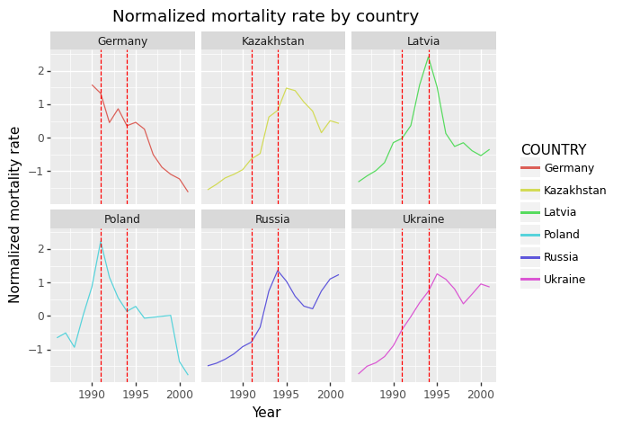
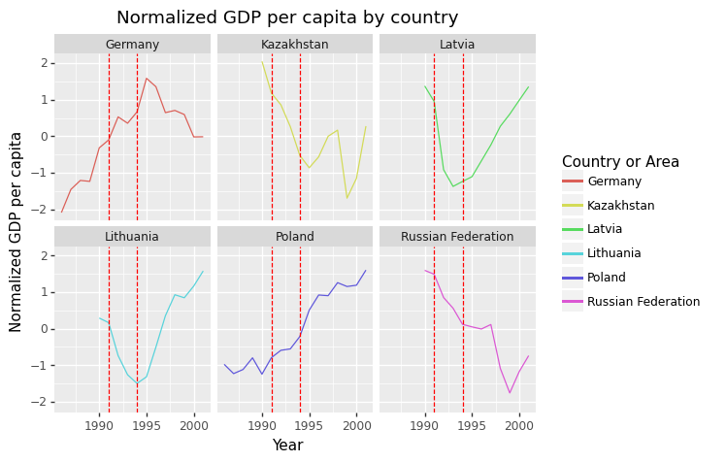
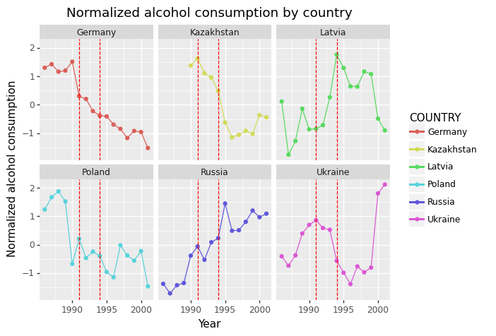
DATA & METHODS
Mortality Rates
Alcohol Consumption
GDP Per Capita
Mortality Data
Life Expectancy
Alcohol Consumption
GDP Data
GDP Per Capita
Sentiment

Slide 12
DATA & METHODS
Mortality Rates
Alcohol Consumption
GDP Per Capita
Mortality Data
Life Expectancy
Alcohol Consumption
GDP Data
GDP Per Capita
Sentiment
Notes:
Mortality increased sharply in 1991-1994

Slide 13
DATA & METHODS
Mortality Rates
Alcohol Consumption
GDP Per Capita
Mortality Data
Life Expectancy
Alcohol Consumption
GDP Data
GDP Per Capita
Sentiment
Notes:
Alcohol consumption did not increase in all countries that experienced mortality declines
Literature points the finger at alcohol consumption as the culprit

Slide 14
DATA & METHODS
Mortality Rates
Alcohol Consumption
GDP Per Capita
Mortality Data
Life Expectancy
Alcohol Consumption
GDP Data
GDP Per Capita
Sentiment
Notes:
All Countries witnessed significant GDP drops which could have lowered the quality of life significantly
Countries began to recover after 1991

Slide 15
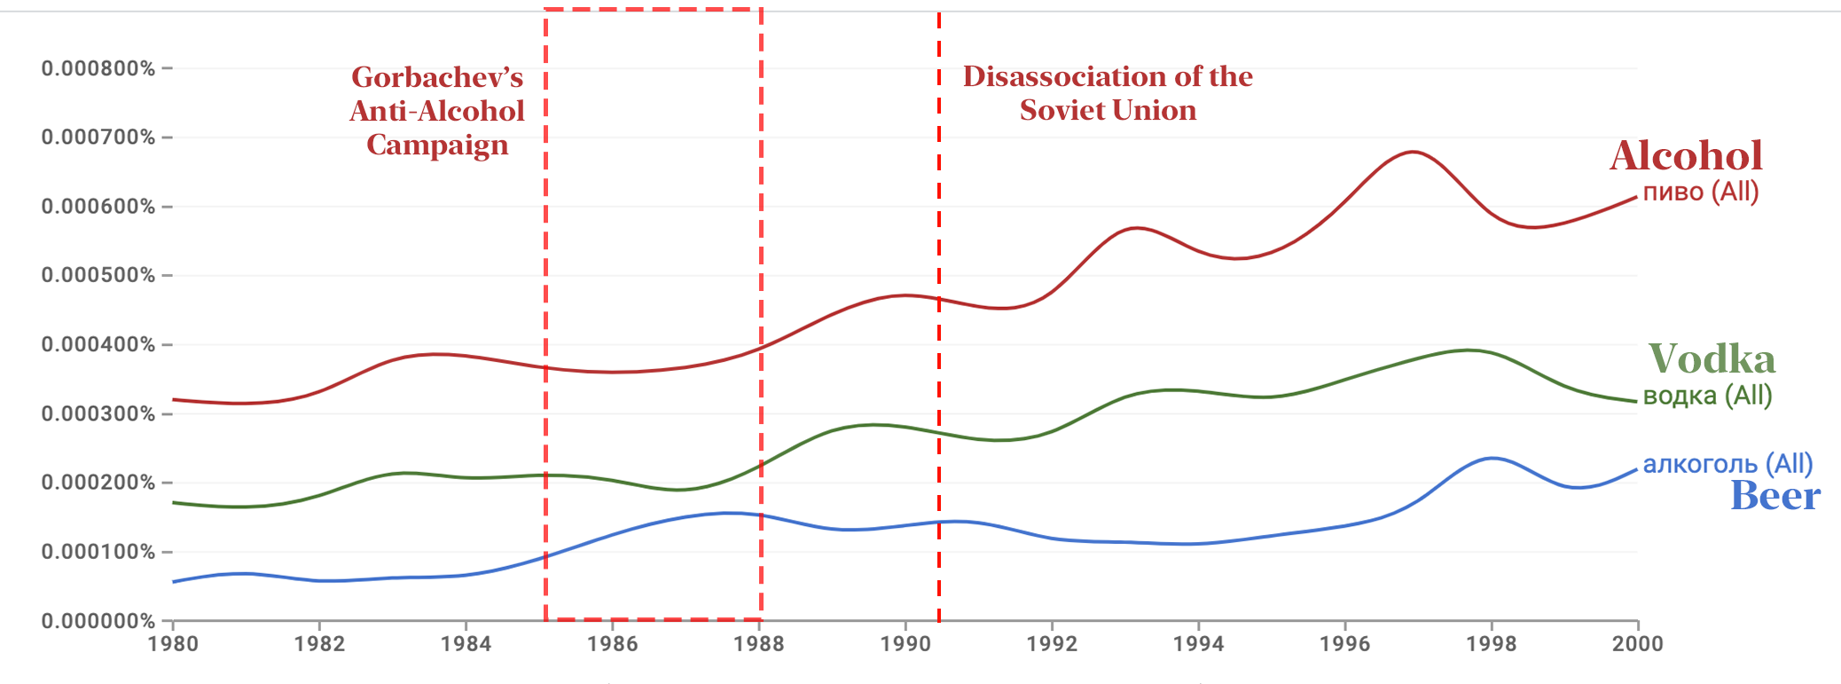
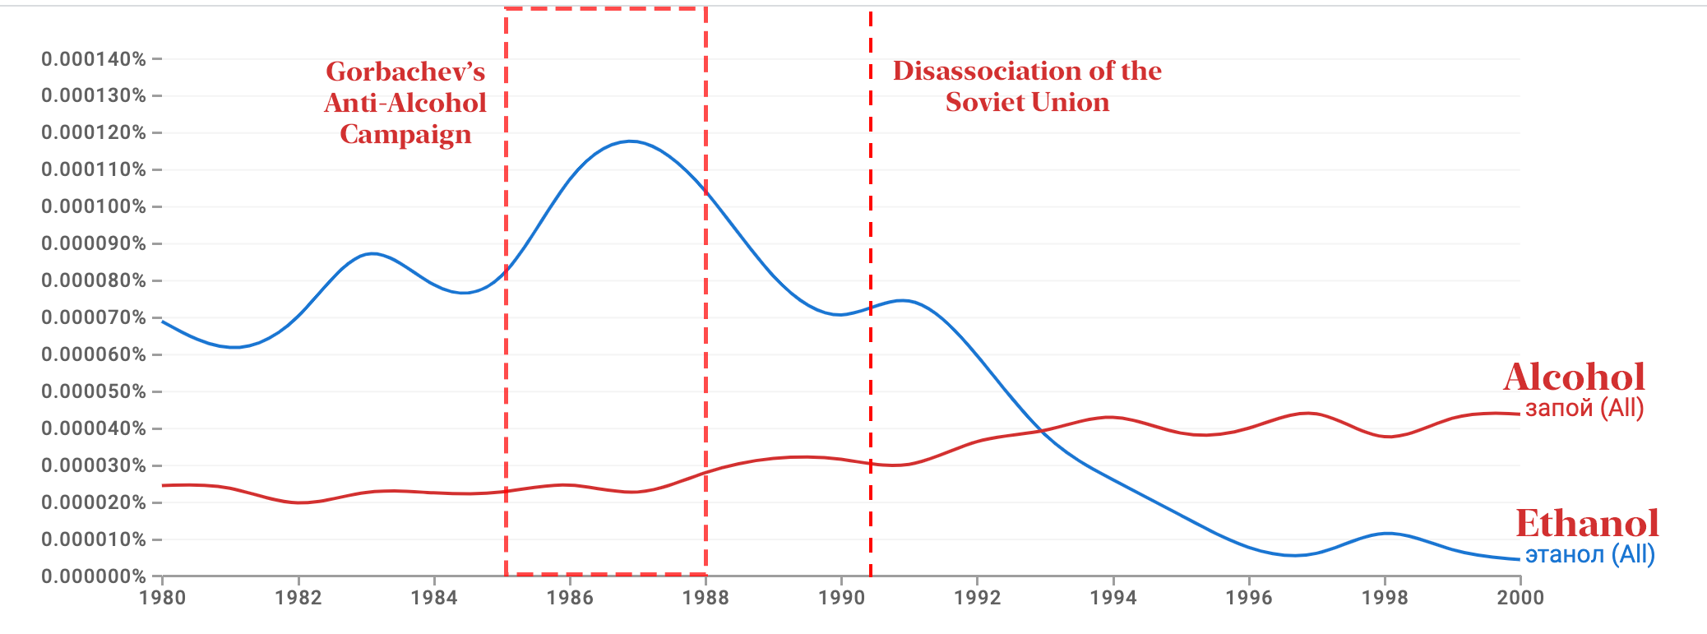
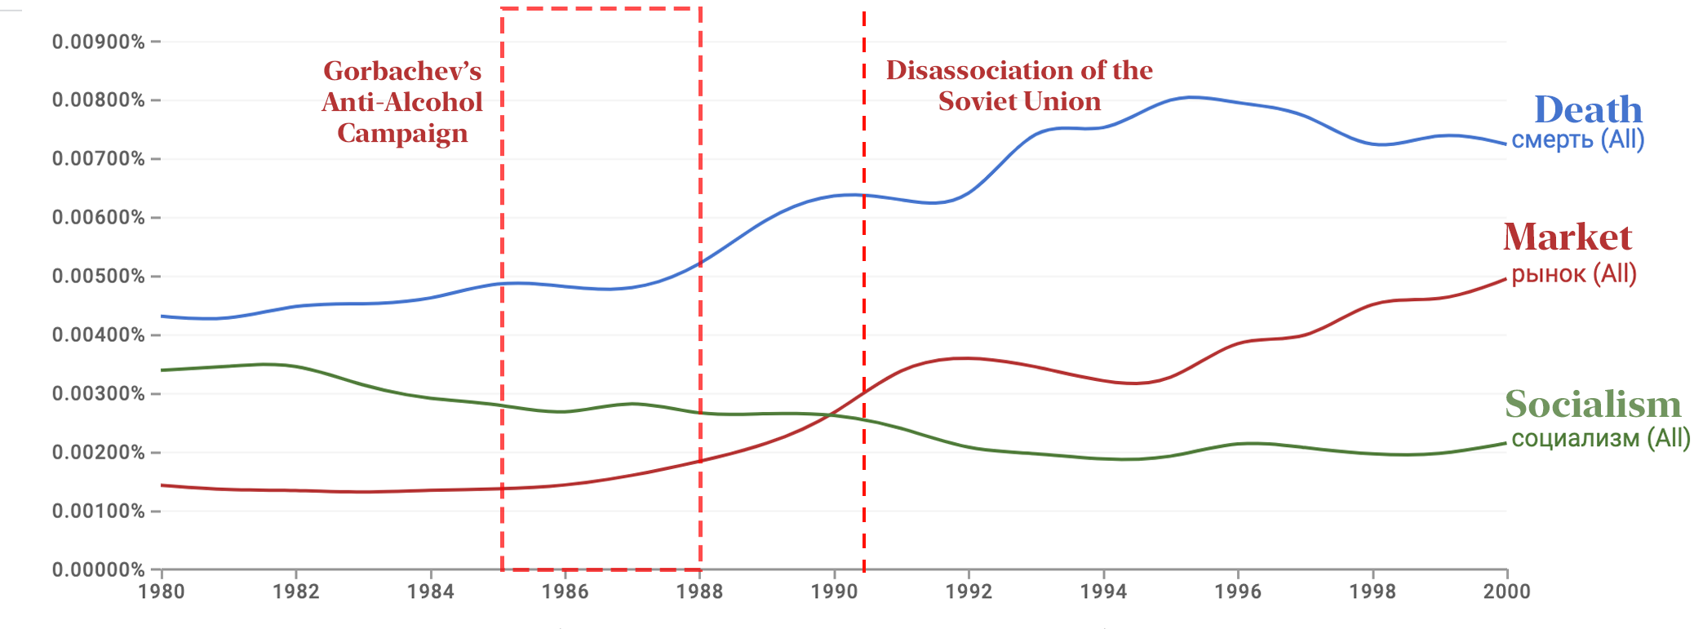
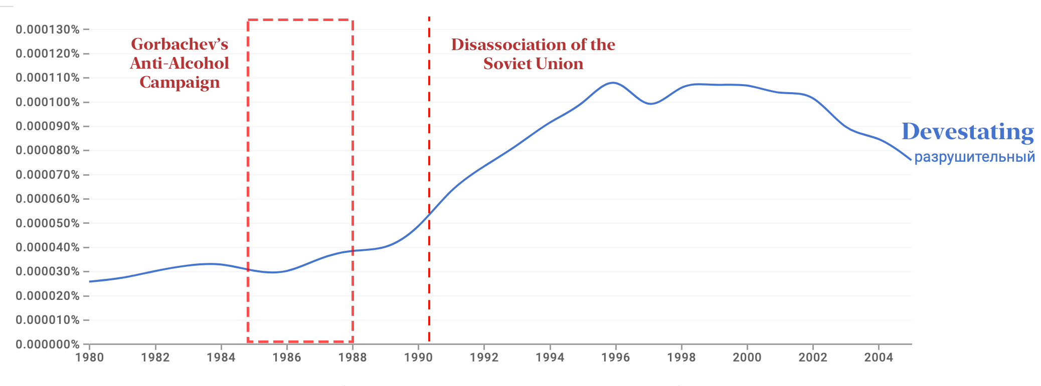
DATA & METHODS
Notes:
The sentiment over alcohol, vodka, and beer was largely the same

Slide 16
DATA & METHODS
Notes:
- However, ethanol grew in popularity in the Russian corpus during both the anti-alcohol campaign and slightly in 1991

Slide 17
DATA & METHODS
Notes:
- A growth in the use of the word ‘market’ but words like ‘death’ and ‘suicide’ plummeted

Slide 18
DATA & METHODS
Notes:
- Interestingly, the word ‘devastating’ was on the rise.
- This points the finger at either a shock that happened in 1990 or that perceived well-being did not really contribute heavily

Slide 19
DISCUSSION
Notes:
Problems:-
Cannot isolate the rich from the public class in Russian data

Slide 20
THANK YOU

